Slide 1
Machine Learning
BCSML601
3:0:2

Slide 2
Pre- requisites
Linear Equations
Probability and Statistics
Graphs of Functions

Slide 3
Course Learning Objectives (CLO)
This course will enable students to,
Define machine learning and understand the basic theory underlying machine learning.
Differentiate supervised, unsupervised and reinforcement learning
Understand the basic concepts of learning and decision trees.
Understand neural networks and Bayesian techniques for problems appear in machine learning
Understand the instant based learning and statistical analysis of machine learning techniques.

Slide 4
MODULE 4
Introduction
Bayes Theorem
Theorem and concept learning
Maximum Likelihood and Least squared error Hypothesis
Maximum Likelihood Hypothesis for predicting
Minimum Description length principle
Naïve Bayes Classifier

Slide 5
Introduction
Bayesian learning algorithms that calculate explicit probabilities for hypotheses, such as the naive Bayes classifier, are among the most practical approaches to certain types of learning problems.
Naive Bayes classifier is among the most effective algorithms for text document classification

Slide 6
Features of Bayesian learning methods
Each observed training example can incrementally decrease or increase the estimated probability that a hypothesis is correct.
This provides a more flexible approach to learning than algorithms that completely eliminate a hypothesis if it is found to be inconsistent with any single example.
Prior knowledge can be combined with observed data to determine the final probability of a hypothesis.
In Bayesian learning, prior knowledge is provided by asserting (1) a prior probability for each candidate hypothesis, and (2) a probability distribution over observed data for each possible hypothesis.
Bayesian methods can accommodate hypotheses that make probabilistic predictions (e.g., hypotheses such as "this pneumonia patient has a 93% chance of complete recovery").
New instances can be classified by combining the predictions of multiple hypotheses, weighted by their probabilities.
Even in cases where Bayesian methods prove computationally intractable, they can provide a standard of optimal decision making against which other practical methods can be measured.

Slide 7
Practical difficulty in applying Bayesian methods
They typically require initial knowledge of many probabilities. When these probabilities are not known in advance they are often estimated based on background knowledge, previously available data, and assumptions about the form of the underlying distributions.
The significant computational cost required to determine the Bayes optimal hypothesis in the general case (linear in the number of candidate hypotheses). In certain specialized situations, this computational cost can be significantly reduced.

Slide 15
BAYES THEOREM
In machine learning, the interest is in determining the best hypothesis from some space H, given the observed training data D.
Notations
P(h) denotes the initial probability that hypothesis h holds, before the training data is observed and is often called the priorprobability of h and may reflect any background knowledge the chance that h is a correct hypothesis.
If no such prior knowledge is there, then simply assign the same prior probability to each candidate hypothesis.
P(D) denotes the prior probability that training data D will be observed (i.e., the probability of D given no knowledge about which hypothesis holds).
P(D | h) denotes likelihood, the probability of observing data D given hypothesis h, ie., More generally, P(x | y) denotes the probability of x given y

Slide 16
Derivation
We Have P(h|D) = P( h ∩ D) / P(D)
And P(D|h) = P( D ∩ h) / P(h)
Also wkt, P( h ∩ D) = P( D ∩ h)
→ P(h|D) * P(D) = P(D|h) * P(h)
→ P(h|D) = (P(D|h) * P(h)) / P(D)
Posterior Likelyhood Prior Marginal
Probability Probability Probability

Slide 17
P (h | D) is called the posteriorprobability of h, because it reflects our confidence that h holds after the training data D is seen.
Bayes theorem is the cornerstone of Bayesian learning methods because it provides a way to calculate the posterior probability P(h | D), from the prior probability P(h), together with P(D) and P(D | h).
Bayes theorem:
P(h|D) increases with P(h) and with P(D|h) according to Bayes theorem.
P(h|D) decreases as P(D) increases, because the more probable it is that D will be observed independent of h, the less evidence D provides in support of h.

Slide 18
Maximum a Posteriori (MAP) Hypothesis
In many learning scenarios, the learner considers some set of candidate hypotheses H and is interested in finding the most probable hypothesis h ∈H given the observed data D( D event has already occurred).
Any such maximally probable hypothesis is called a maximum a posteriori (MAP) hypothesis.
MAP learning selects a single most likely hypothesis given the data
Bayes theorem to calculate the posterior-probability of each candidate hypothesis is h _{MAP} is a MAP hypothesis provided
P(D) can be dropped, because it is a constant, independent of h

Slide 19
Maximum Likelihood (ML) Hypothesis
In some cases, it is assumed that every hypothesis in H is equally probable a priori (P(h_{i}) = P(h_{j}) for all h_{i} and h_{j} in H).
In this case the below equation can be simplified and need only consider the term P(D|h) to find the most probable hypothesis.
P(D|h) is often called the likelihood of the data D given h, and any hypothesis that maximizes P(D|h) is called a maximum likelihood (ML) hypothesis

Slide 20
Example
Consider a medical diagnosis problem in which there are two alternative hypotheses
The patient has a particular form of cancer (denoted by cancer)
The patient has no cancer (denoted by ¬ cancer)
The available data is from a particular laboratory with two possible outcomes: + (positive) and -(negative)

Slide 21
We have prior knowledge that over the entire population of people only 0.008 have this disease.
Furthermore, the lab test is only an imperfect indicator of the disease.
The test returns a correct positive result in only 98% of the cases in which the disease is actually present and a correct negative result in only 97% of the cases in which the disease is not present.
In other cases, the test returns the opposite result.
Suppose a new patient is observed for whom the lab test returns a positive (+) result.
Should we diagnose the patient as having cancer or not?

Slide 23
Work out problems of Bayes Theorem
In a neighbourhood, 90% children were falling sick due flu and 10% due to measles and no other disease. The probability of observing rashes for measles is 0.95 and for flu is 0.08. If a child develops rashes, find the child’s probability of having flu.
Given, Dangerous fires are rate (1%), Smoke is fairly common (10%) due to barbecues and 90% of dangerous fires make smoke, Calculate the probability of a dangerous Fire when there is Smoke.
There are three identical cards except that both the sides of the first card is coloured red, both sides of the second card is coloured blue and for the third card one side is coloured red and the other side is blue. One card is randomly selected among these three cards and put down, visible side of the card is red. What is the probability that the other side is blue?

Slide 24
BAYES THEOREM AND CONCEPT LEARNING
What is the relationship between Bayes theorem and the problem of concept learning?
Bayes theorem provides a principled way to calculate the posterior probability of each hypothesis given the training data
We can use it as the basis for a straightforward learning algorithm that calculates the probability for each possible hypothesis
then outputs the most probable.

Slide 25
Brute-Force Bayes Concept Learning
Consider some finite hypothesis space H defined over the instances space X, in which the task is to learn some target concept c: X → {0,1}.
Sequence of instances (x₁ . . . x_{m}) and sequence of target values D= (d₁, . . . d_{m}).
The sequence of training examples ((x₁,d₁), (x₂,d₂). . . (x_{m},d_{m})) , where x_{i} is some instance from X and where t_{i} is the target value of x_{i} defined as d_{i}=c(x_{i}).
If the instance belongs to H, then x = 1, else x = 0
X= 1
X = 0
H

Slide 26
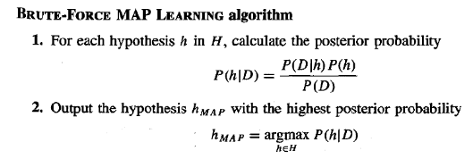

Slide 27
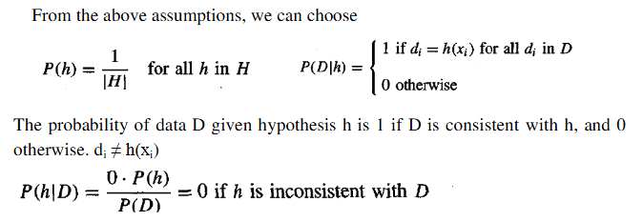
Assume
The training data D is noise free, i.e., d_{i} = c(x_{i})),
The target concept c is contained in the hypothesis space H
Each hypothesis is equally probable and independent of each other., if ther e are 5 instances, then probability of each is 1/5
Sum of prior probabilities is 1 ( 1/5+1/5+1/5+1/5+1/5) = 1/ |H|

Slide 28
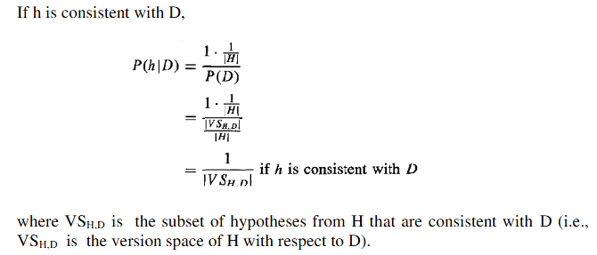

Slide 29
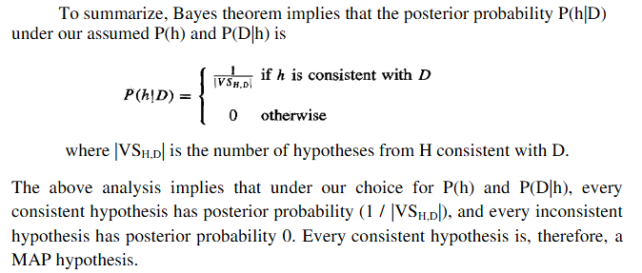

Slide 30

Maximum Likelihood and Least squared error Hypothesis
Under certain assumptions, any learning algorithm that minimizes the squared error between the output hypothesis predictions and the training data will output a maximum likelihood hypothesis.
Show that the least-squared error hypothesis is the maximum likelihood hypothesis:
Where p refers to probability density

Slide 31


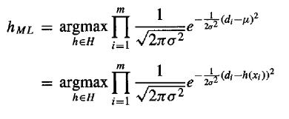
Assume a fixed set of training instances (x₁ . . . x_{m}) and the data D to be the corresponding sequence of target values D = (d₁ . . .d_{m}).
Assume the training examples are mutually independent given h, P(D|h) can be written as the product of the various p(d_{i}|h).
p(di|h) can be written as a Normal distribution with variance = σ2 and mean µ = h (x_{i}).
The normal distribution formula is
Substituting , we get,

Slide 32
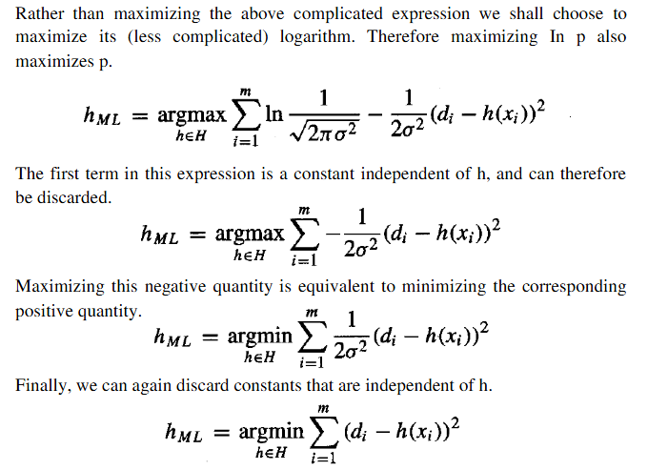

Slide 33
Thus, the above equation shows that the maximum likelihood hypothesis h_{ML} is the one that minimizes the sum of the squared errors between the observed training values d and the hypothesis predictions h(x_{i}).

Slide 34
MINIMUM DESCRIPTION LENGTH(MDL) PRINCIPLE
Representing a concept in minimum possible way – Then it is said to be good one.
That means shorter hypothesis/shorter decision tree.
Choosing the shortest explanation for the observed data

Slide 35
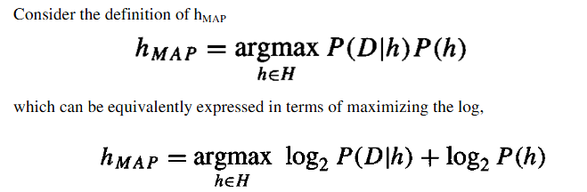
The Minimum Description Length (MDL) principle recommends choosing the hypothesis that minimizes the sum of these two description lengths
or alternatively, minimizing the negative of this quantity

Slide 36
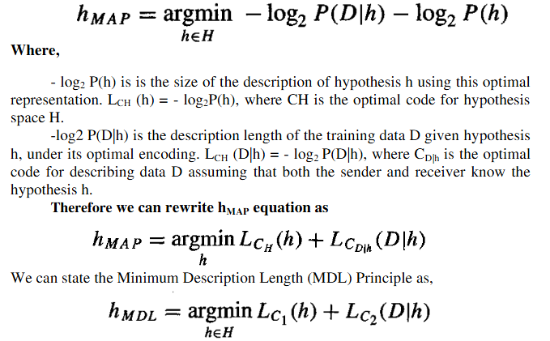
The below statement interpreted that short hypotheses are preferred

Slide 37
NAIVE BAYES CLASSIFIER
Naive Bayes classifiers are supervised machine learning algorithms used for classification tasks, based on Bayes’ Theorem to find probabilities.
The main idea behind the Naive Bayes classifier is to use Bayes’ Theorem to classify data based on the probabilities of different classes given the features of the data. It is used mostly in high-dimensional text classification
It is a probabilistic classifier because it assumes that one feature in the model is independent of existence of another feature. In other words, each feature contributes to the predictions with no relation between each other.
It calculates the probability of a sample belonging to a particular class based on the probabilities of its features.
For example, a phone may be considered as smart if it has touch-screen, internet facility, good camera, etc. Even if all these features are dependent on each other, but all these features independently contribute to the probability of that the phone is a smart phone.

Slide 38
Example1:
Consider a dataset of weather conditions and corresponding target variable "Play".
Using this dataset we need to decide that whether we should play or not on a particular day according to the weather conditions.
To solve this problem, follow the below steps:
1. Convert the given dataset into frequency tables.
2. Generate Likelihood table by finding the probabilities of given features.
3. use Bayes theorem to calculate the posterior probability.
Problem: If the weather is sunny, then the Player should play or not?

Slide 39
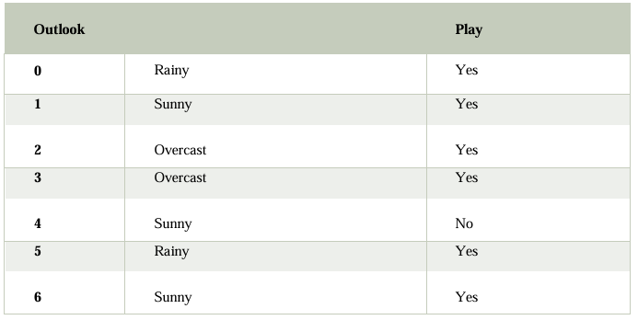
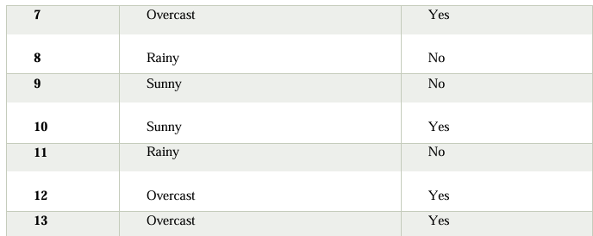

Slide 40
Step1: Frequency table for weather Step2: Likelyhood table for weather
Weather | Yes | No
Overcast | 5 | 0
Rainy | 2 | 2
Sunny | 3 | 2
Total | 10 | 4
Weather | Yes | No
Overcast | 5 | 0 | 5/14= 0.355
Rainy | 2 | 2 | 4/14 = 0.29
Sunny | 3 | 2 | 5/14 = 0.355
Probability | 10/14=0.71 | 4/14 = 0.29

Slide 41
Step3: Apply Bayes Theorm
P(Yes|Sunny)= P(Sunny|Yes)*P(Yes)/P(Sunny)
P(Sunny|Yes)= 3/10= 0.3 , P(Sunny)= 0.355 , P(Yes)=0.71
So → P(Yes|Sunny) = 0.3*0.71/0.355 = 0.60
P(No|Sunny)= P(Sunny|No)*P(No)/P(Sunny)
P(Sunny|No)= 2/4 = 0.5 , P(No)= 0.29 , P(Sunny)= 0.355
So → P(No|Sunny)= 0.5*0.29/0.355 = 0.41

Slide 42
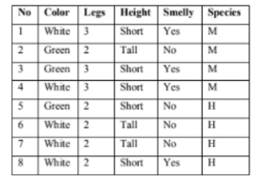
Example2:
The following table gives dataset about different Species {M, H}. Use Naïve Bayes classifier to classify the new data {Color = Green, Legs=2, Height=Tall, Smelly=No , Class=?}

Slide 43
Solution:
first calculate the probability of the species being M or H in total.
P(Species=M)=4/8=0.5, P(Species=H)=4/8=0.5
2. calculate the conditional probability of each attribute value for each class label.
Color | M | H
White | 2/4 = 0.5 | ¾=0.75
Green | 2/4 =0.5 | ¼ = 0.25
Legs | M | H
2 | ¼ = 0.25 | 4/4 = 1
3 | ¾ = 0.75 | 0/4 = 0
Height | M | H
Tall | 1/4=0.25 | 2/4 = 0.5
Short | 3/4 = 0.75 | 2/4 = 0.5
Smelly | M | H
Yes | ¾=0.75 | ¼=0.25
No | ¼=0.25 | ¾=0.75

Slide 44
Calculate the probability of the new attribute set belonging to a single class.
{Color = Green, Legs=2, Height=Tall, Smelly=No , Class=?}
The probability of X belonging to Species M will be as follows:
P(M/X) =P(M)*P(Green/M)*P(Legs2/M)*P(Tall/M)*P(Smell=No/M)
= 0.5 * 0.5 * 0.25 * 0.25 * 0.25 = 0.0039
The probability of X belonging to Species H will be as follows:
P(H/X) = P(H)*P(Green/H)*P(Legs2/H)*P(Tall/H)*P(Smell=No/H)
= 0.5 * 0.25 * 1 * 0.5 * 0.75 = 0.4688
The probability is high that X belongs to Species H

Slide 45
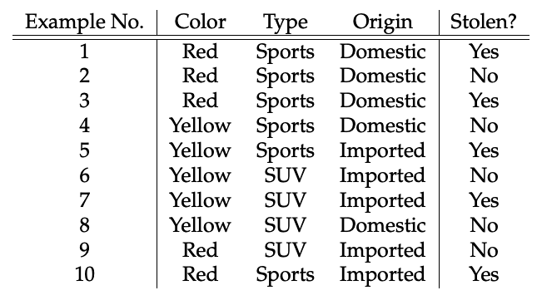
Example3:
Consider the car theft problem with attributes Color, Type, Origin, and the target, Stolen can be either Yes or No. Estimate the conditional probabilities values for the new instance {Color=Red, Type=SUV, Origin = Domestic}

Slide 46
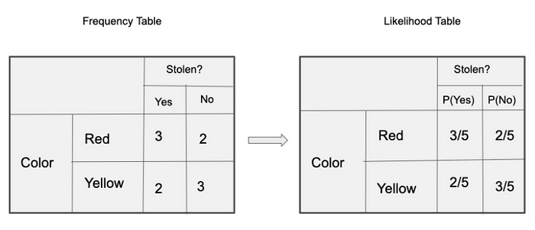
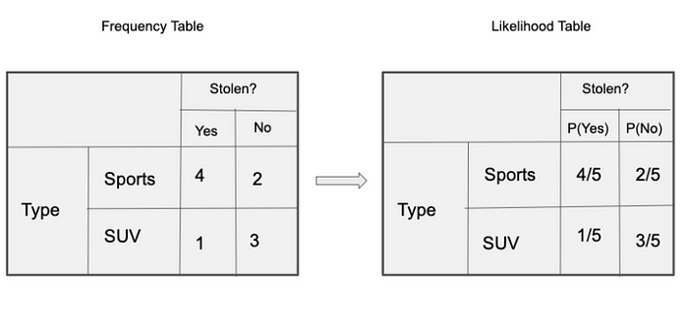
Solution
Problem is to classify a Red Domestic SUV is getting stolen or not.
Frequency table and likelyhood tables

Slide 47
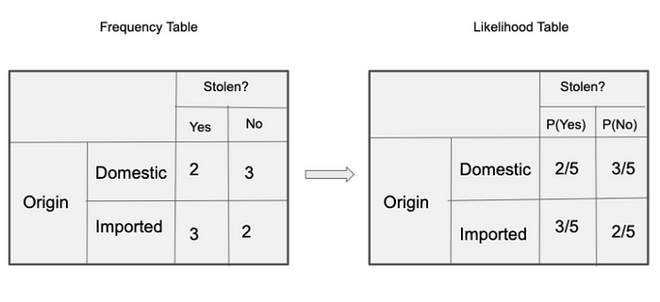

Slide 48
The list of features to consider as - Feature = (Red, SUV, Domestic)
To determine car is stolen ‘YES’
P(Yes|Feature) = P(Red|Yes) * P(SUV|Yes) * P(Domestic|Yes) * P(Yes)
To determine the car is not stolen ‘NO’
P(No|Feature) = P(Red|No) * P(SUV|No) * P(Domestic|No) * P(No)
Find the conditional probabilities :
P(Yes|Feature) = 3/5 * 1/5 * 2/5 * 5/10 = 0.024
P(No|Feature) = 2/5 * 3/5 * 3/5 * 5/10 = 0.072
Since 0.072 > 0.024, given the features RED, SUV and Domestic, the example gets classified as ’NO’ , ie., the car is not stolen.

Slide 49
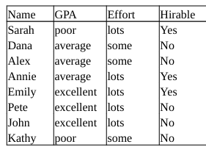
Example 4:
Consider the following hypothetical data concerning student characteristics and whether or not each student should be hired.
Use a Naive Bayes classifier to determine whether or not someone with poor GPA, and lots of effort should be hired.

Slide 50
Solution
GPA | HYes | HNo
Poor | 1/3 | 1/5
Average | 1/3 | 2/5
Excellent | 1/3 | 2/5
Efforts | HYes | HNo
Lots | 3/3 | 2/5
Some | 0/3 | 3/5

Slide 51
Calculate the conditional probability for a student to be hirable and not hirable:
Attributes (A) = {GPA = poor, Efforts=lots, Hirable=?}
P(HYes|A) = P(HYes) * P(poor|Hyes) * P(lots|Hyes)
= 3/8 * 1/3 * 3/3 = 0.125
P(Hno|A) = P(HNo) * P(poor|HNo) * P(lots|HNo)
= 5/8 * 1/5 * 2/5 = 0.05
Since 0.125 > 0.05, the student is Hirable

Slide 52
Thank You

